Slide 1
Quality review
Database Design

Slide 2
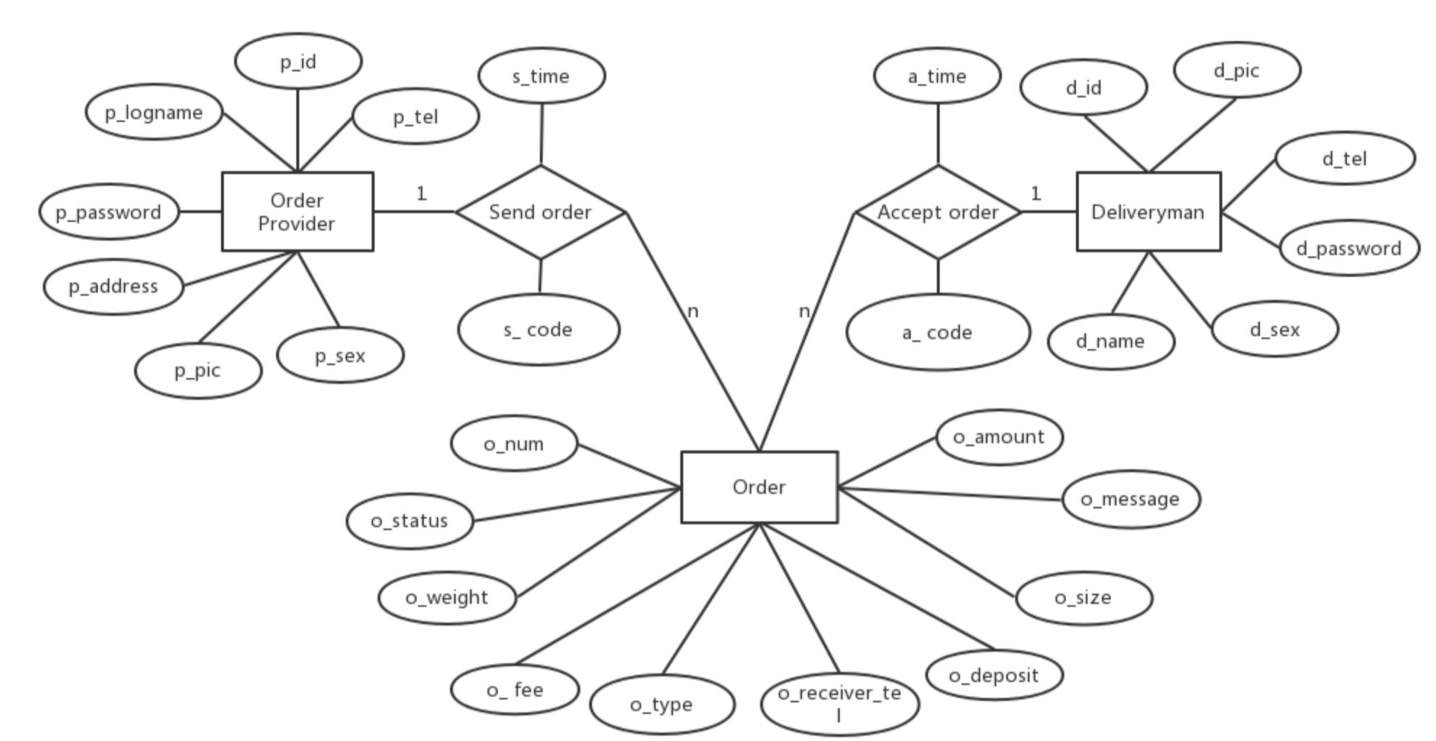
Database Design

Slide 3
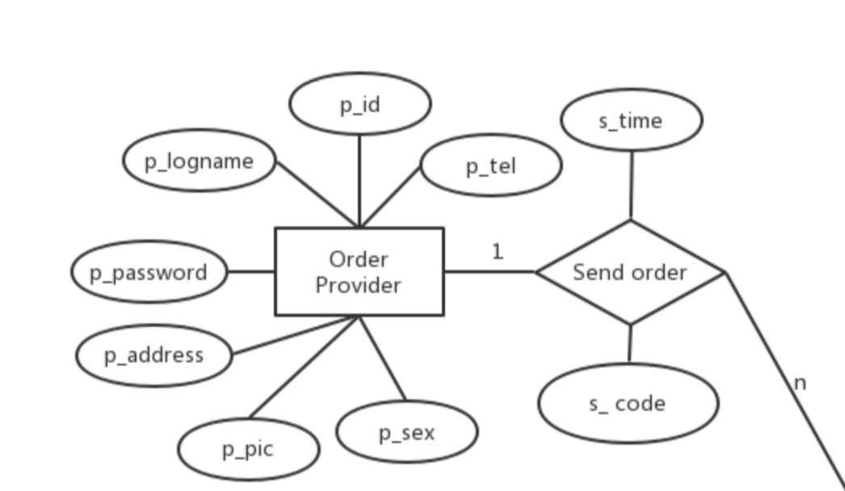

Slide 4
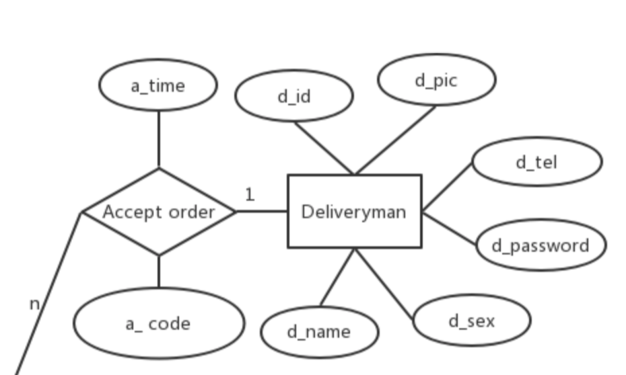

Slide 5
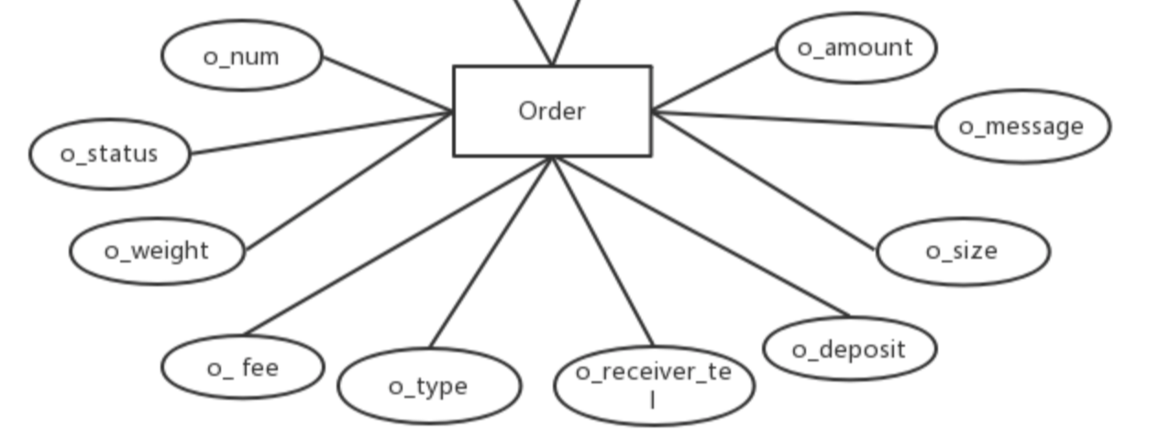

Slide 6


Slide 7
Thanks for your time
Database Design

